Slide 1

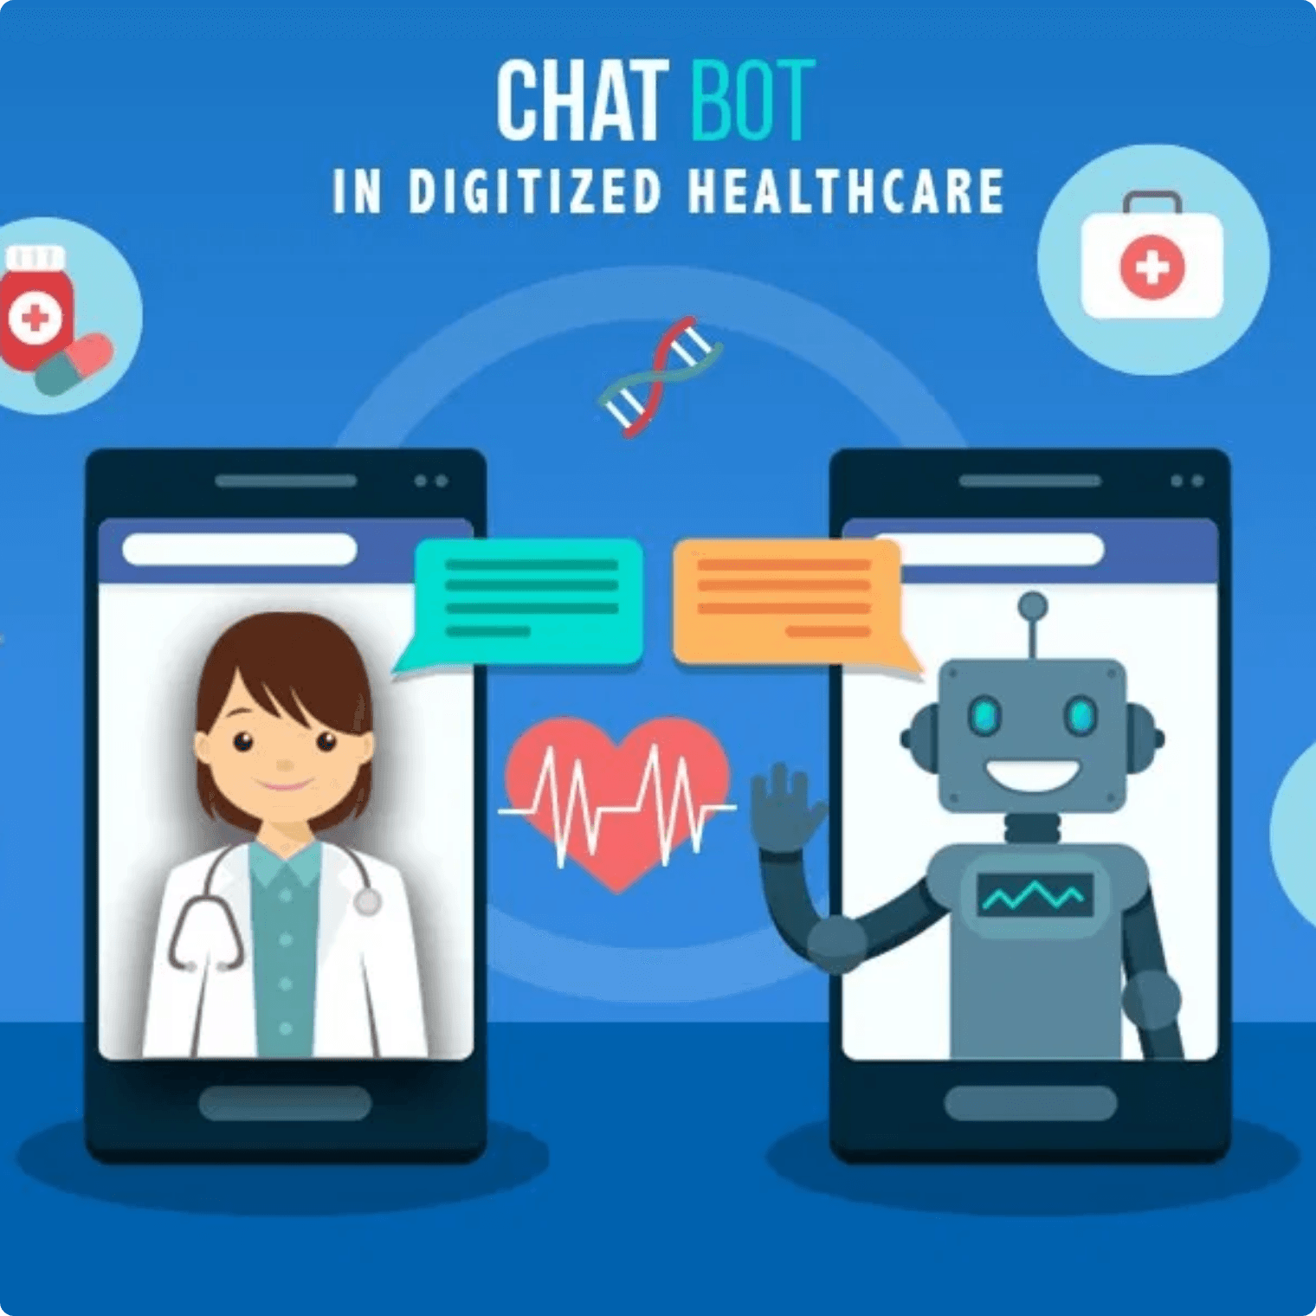
Medical Chatbot
RAG for Medical Information Retrieval
JSPM's Rajarshi Shahu College of Engineering
Tathawade, Pune
Department of Computer Science and Business Systems
Project Team
Pratik Rajendra Patil
(RBT23CB026)
Atharv Pramod Barge
(RBT23CB034)
Faculty Guide
Prof. Parul Rajwade

Slide 2

Problem & Objective
Addressing LLM Hallucination in Medical Domains
The Challenge
Key Features
Standard Large Language Models (LLMs) are prone to hallucination—generating plausible but incorrect or fabricated information. In medical domains, this poses a serious risk to user safety and trust.
Context-Aware Answers: Strictly based on encyclopedia content
▸
Voice-Enabled UI: Hands-free interaction with speech-to-text and text-to-speech
▸
Interactive Interface: Clean, responsive Streamlit application
▸
Risk: Inaccurate medical information can mislead users and compromise their health decisions.
Medical Disclaimer: Prominently displayed for responsible use
▸
Fast Retrieval: Efficient FAISS vector database search
▸
Our Solution
Build a factually-grounded Q&A chatbot using RAG architecture
Scope & Limitations
Knowledge Source: The Gale Encyclopedia of Medicine (Static)
Ground all answers exclusively in The Gale Encyclopedia of Medicine
▸
No Live Internet: Strictly limited to provided knowledge base
▸
Eliminate hallucination through retrieval-augmented generation
Informational Only: Not a substitute for professional medical advice
▸
Stateless: No user data or chat history stored
Provide a user-friendly, voice-enabled interface
▸
Aligned with
SDG 3: Good Health & Well-being

Slide 3

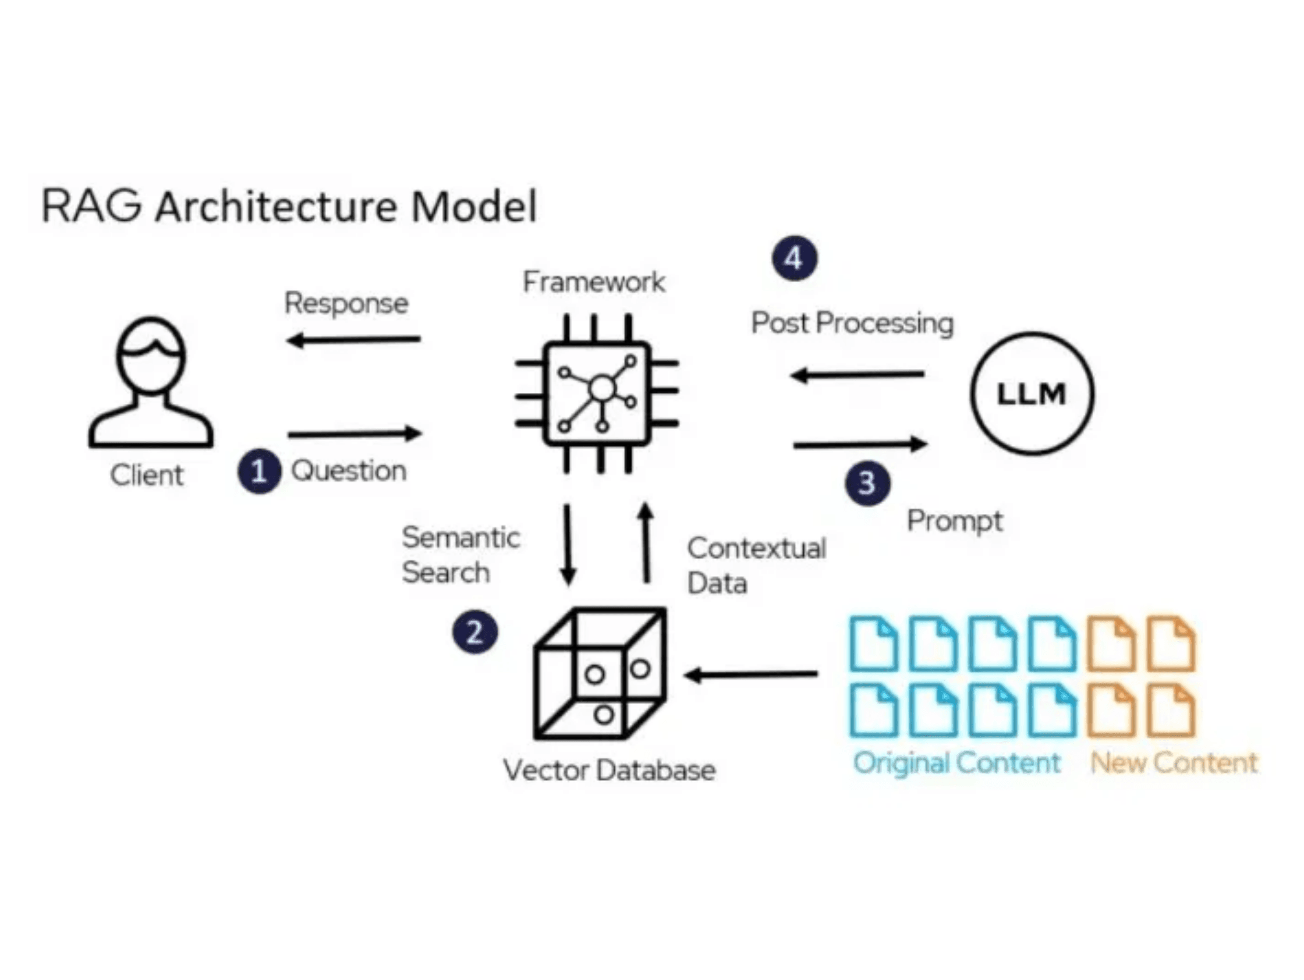
RAG Architecture
Retrieval, Augmentation, and Generation Pipeline
Core Concept: RAG enhances a Large Language Model (LLM) by integrating an external knowledge retrieval system. This hybrid approach ensures factually accurate answers grounded in trusted sources.
1
Retrieve
When a user asks a question, the system embeds the query and searches the FAISS vector database to retrieve the most relevant text chunks from The Gale Encyclopedia of Medicine.
Technology: FAISS (Facebook AI Similarity Search) for fast, high-speed document retrieval
2
Augment
The retrieved text chunks are injected into the prompt as context, alongside the user's original question, creating a rich, contextual input.
The augmented prompt ensures the LLM has access to verified, source-based information
Why RAG for Medical Domains?
Eliminates hallucination through source grounding
Enables source verification and transparency
3
Knowledge base updates without LLM retraining
Fast, efficient retrieval at scale
Generate
The Mistral-7B LLM processes the augmented prompt and generates a factually-grounded answer based exclusively on the provided context.
Custom prompt enforces: "If you don't know, say so. Don't make up answers."

Slide 4

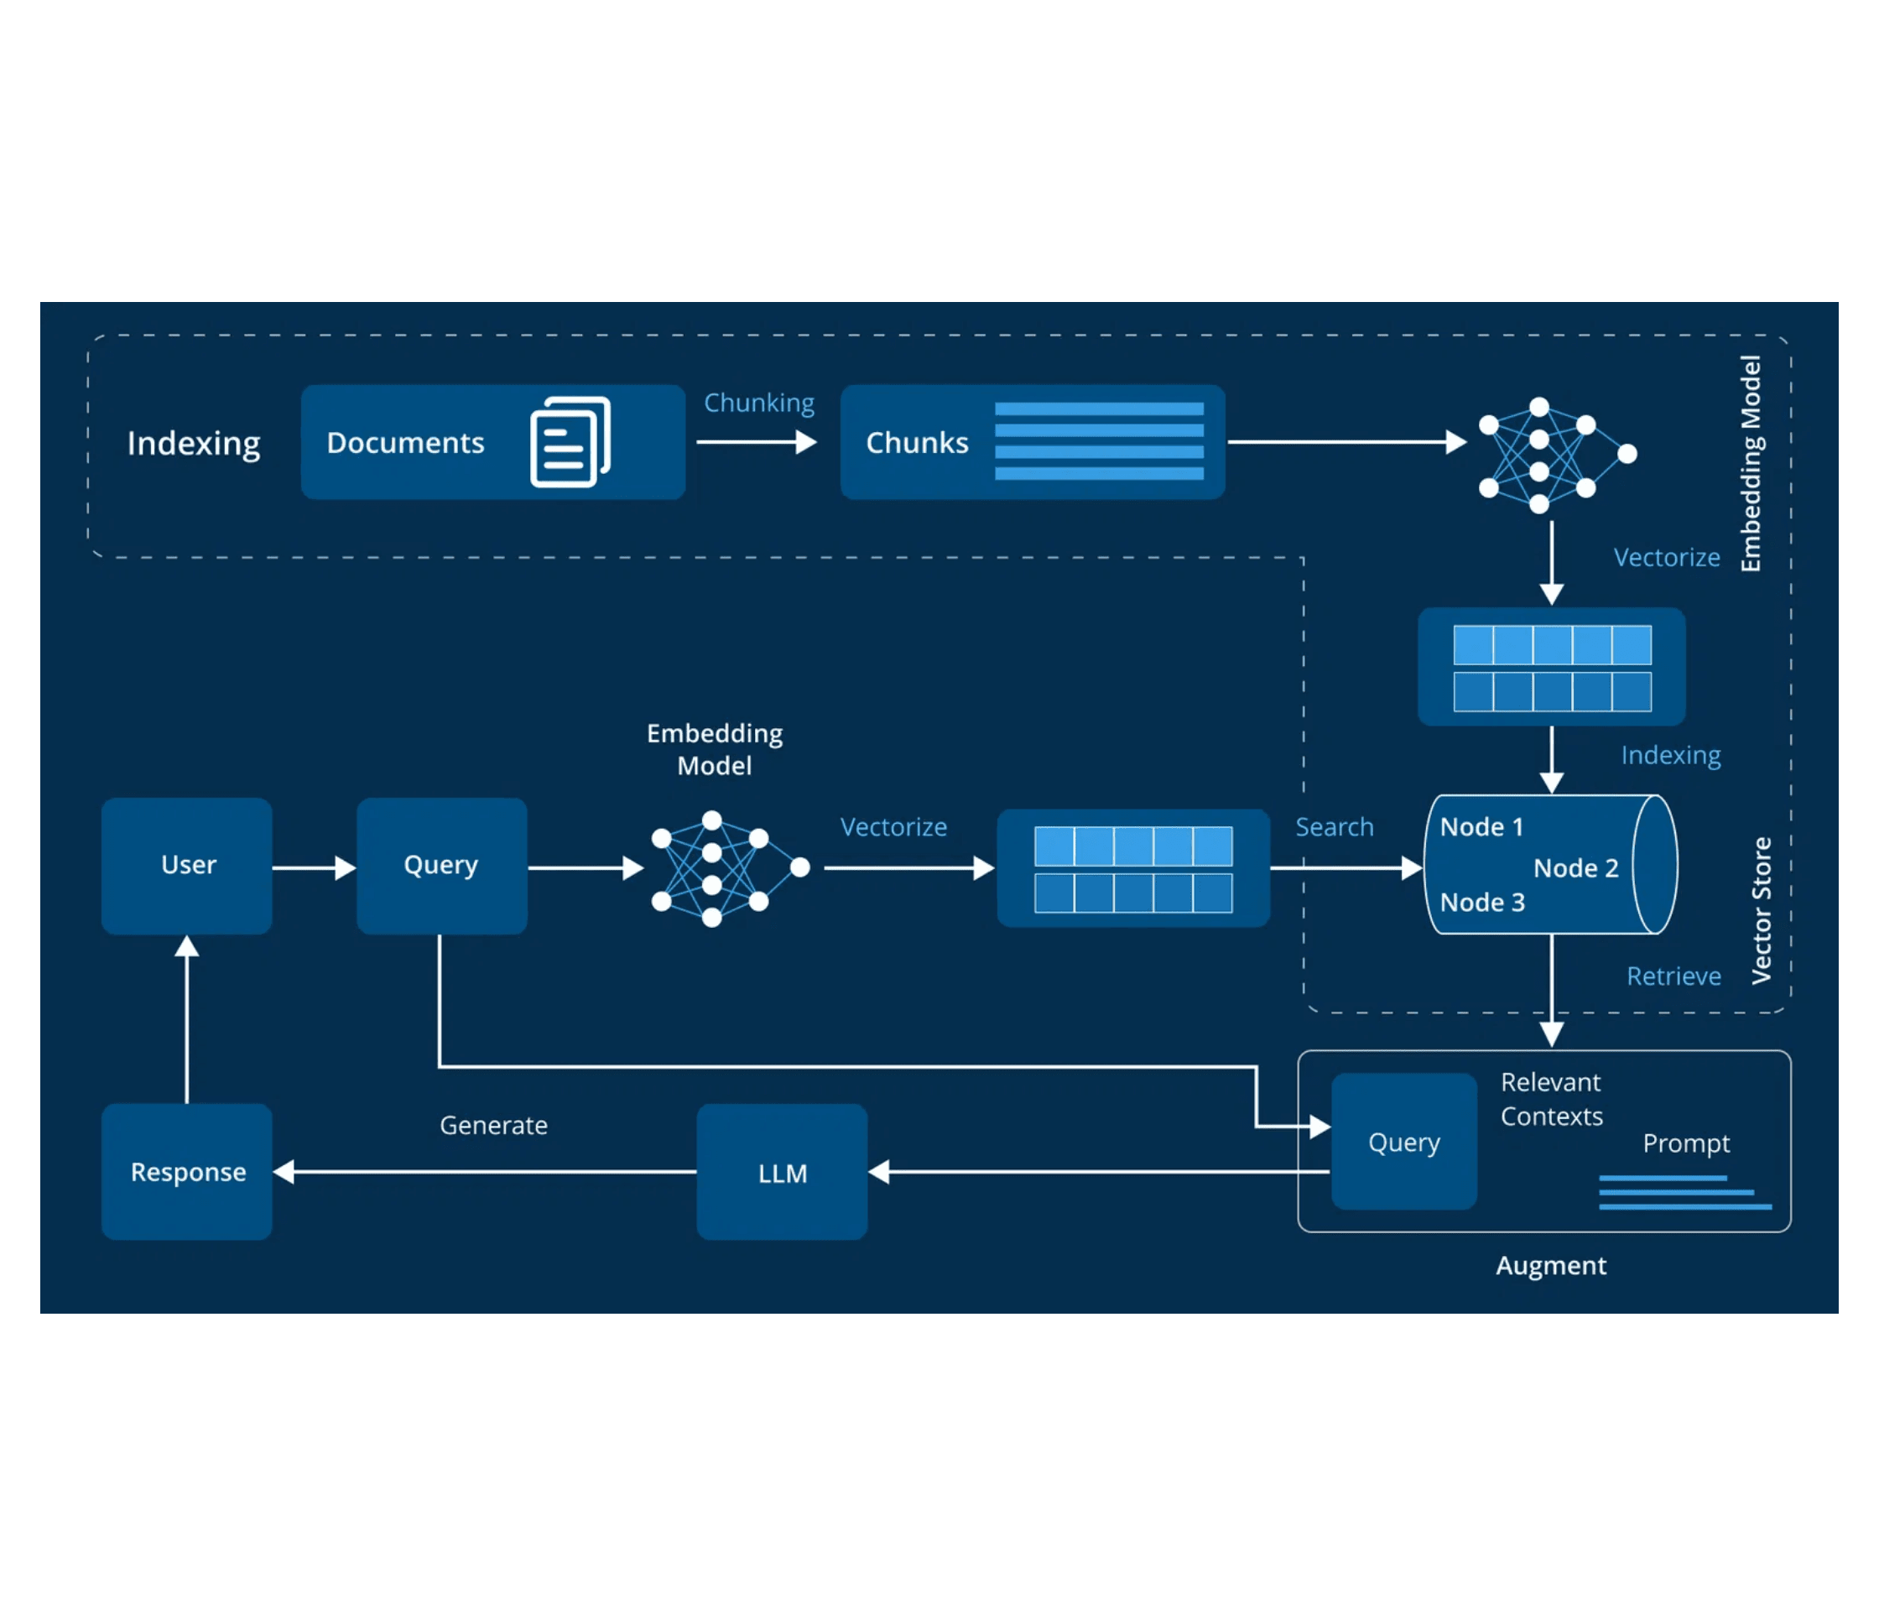
Technical Implementation
Three-Module Architecture
1
Data Ingestion & Vectorization
Purpose: Process source PDF and create searchable knowledge base
Load: Ingest The Gale Encyclopedia of Medicine PDF
→
Chunk: Split document into overlapping text pieces
→
Embed: Convert chunks to vectors using all-MiniLM-L6-v2
→
Store: Save vectors in FAISS database
→
Tech: LangChain, HuggingFace Embeddings, FAISS
2
Core RAG Pipeline
Purpose: Orchestrate query, retrieval, and answer generation
Retrieve: Find relevant text chunks from FAISS database
→
Augment: Inject retrieved chunks into prompt as context
→
Generate: Send augmented prompt to Mistral-7B LLM
→
Return: Deliver factually-grounded answer to user
→
Tech: LangChain, HuggingFace Endpoint, Mistral-7B
3
User Interface (Streamlit)
Complete RAG Pipeline: From Data Ingestion to Response Generation
Purpose: Provide interactive front-end for users
Chat Interface: Web-based conversation management
→
Voice Input: Speech-to-text via streamlit_mic_recorder
→
Voice Output: Text-to-speech via gTTS
→
Display: Show chat history and responses in real-time
→
Tech: Streamlit, gTTS, streamlit_mic_recorder

Slide 5

Results, Conclusion & Future
Project Outcomes and Strategic Enhancements
Key Results
Conclusion
Future Enhancements
Functional Prototype
The Retrieval-Augmented Generation (RAG) architecture has proven to be a highly effective and reliable solution for building domain-specific, factually-grounded AI assistants from static knowledge bases.
Source Display
Successfully deployed "MediChat," a fully operational voice-enabled medical Q&A chatbot with text and speech interfaces.
Enhance UI to display retrieved source text chunks alongside answers for user verification and transparency.
By combining the generative capabilities of Large Language Models with the accuracy of retrieval systems, we have successfully transformed a general-purpose LLM into a specialized medical expert system.
Hallucination Elimination
Formal Evaluation
RAG pipeline consistently produces answers grounded exclusively in The Gale Encyclopedia of Medicine, preventing fabricated information.
Implement quantitative metrics (e.g., RAGAs framework) for rigorous performance analysis and benchmarking.
Key Insight: RAG is the optimal approach for applications requiring high factual accuracy and source verifiability, particularly in safety-critical domains like healthcare.
Performance
Dynamic Knowledge
Fast query response times achieved through efficient FAISS vector database retrieval and optimized embedding search.
Integrate with live database systems to enable real-time knowledge base updates without system downtime.
Accuracy
User Features
All generated answers verified against source text chunks, ensuring factual correctness and traceability.
Add conversation history, export options, and personalized user profiles for enhanced engagement.

Slide 6


References & Technology Stack
Core Technologies and Knowledge Sources
Core Research
RAG Orchestration
Retrieval-Augmented Generation for Knowledge-Intensive NLP Tasks
LangChain
Lewis, P., et al. (2020). NeurIPS.
◆
Framework for building and orchestrating the RAG pipeline with modular components
Mistral 7B
Jiang, A. Q., et al. (2023). Mistral AI.
Sentence-Transformers: Semantic Textual Similarity
Vector Storage & Retrieval
Reimers, N., & Gurevych, I. (2019).
FAISS (Facebook AI Similarity Search)
◆
Knowledge Source
High-speed, efficient vector database for fast document retrieval at scale
The Gale Encyclopedia of Medicine
Second Edition
Longe, J. L. (Ed.). (2002). Gale Group.
Language Model
Mistral-7B-Instruct-v0.2
◆
Open-source LLM for generating factually-grounded answers
Web Interface
Streamlit
◆
Python framework for building interactive, responsive web applications
We extend our gratitude to Prof. Parul Rajwade for her invaluable guidance and support throughout this project. Special thanks to JSPM's Rajarshi Shahu College of Engineering for providing the resources and infrastructure to develop this innovative solution.
streamlit_mic_recorder & gTTS
◆
Speech-to-text and text-to-speech capabilities for voice interaction
Model Access & Embeddings
Hugging Face Hub
◆
Access to LLMs and embedding models; all-MiniLM-L6-v2 for text embeddings

